Slide 1




Indian Particle Accelerator Conference InPAC-2015
Status of the Acculinna-2
RIB Fragment Separator
W. Beeckman, M. Cavellier, S. Antoine, P. Bocher, O. Cosson, F. Forest,
N. Huttin, P. Jehanno, P. Jivkov, C. Kellener, A. Kreiss, J.L. Lancelot, M.J. Leray, X. Milpied, R. Riedinger, O. Tasset,
SIGMAPHI, F-56000 Vannes, FRANCE
A.S. Fomichev, L.V. Grigorenko, V.I. Kazacha, S.A. Krupko, S.V. Stepantsov, G.M. Ter-Akopian
Flerov Laboratory of Nuclear Reactions, JINR, RU-141980 Dubna, Russia
Dr Matthieu CAVELLIER
SIGMAPHI - France
December 22, 2015 - B2 - Session IV- Paper No 370

Slide 2

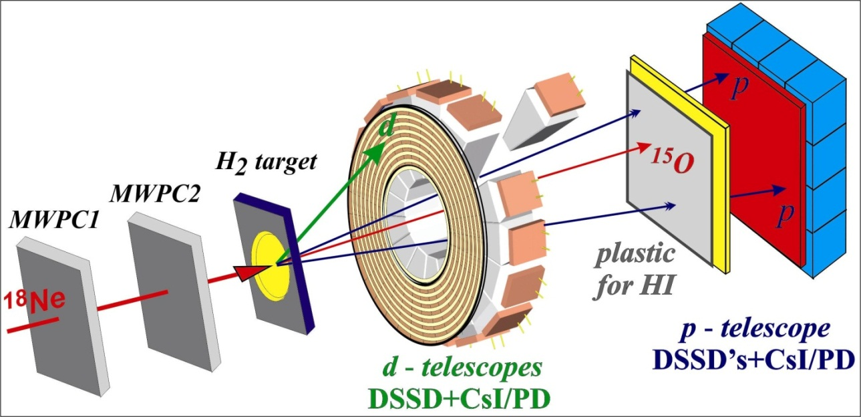
The Acculinna-2 Fragment separator
In-flight RIB separator
Selected
RIB(s)
F5
Target
Unstable
nucleus
Decay nuclei
0° dipole
Detectors
measurement
Acculinna-2
Selector
Decay
(Protons)
adds ¹p / ⁰n
(Neutrons)
¹⁸Ne
¹⁸Ne
¹⁷Ne*
¹⁵O
RIBs
Projectile
fragments
≅ direction
≅ energy
Acculinna-2
Selector
(p,d)
¹⁷Ne*
Decay
¹p
¹p
¹⁸Ne
+ others
P~17%
¹⁸Ne
²⁰Ne
Projectile
fragmentation
²⁰Ne⁷⁺
fragmentation
¹⁷F
¹⁶O
¹⁵N
F1 Target
Solid Be
Primary
beam
²⁰Ne⁷⁺
54 AMeV
U400

Slide 3
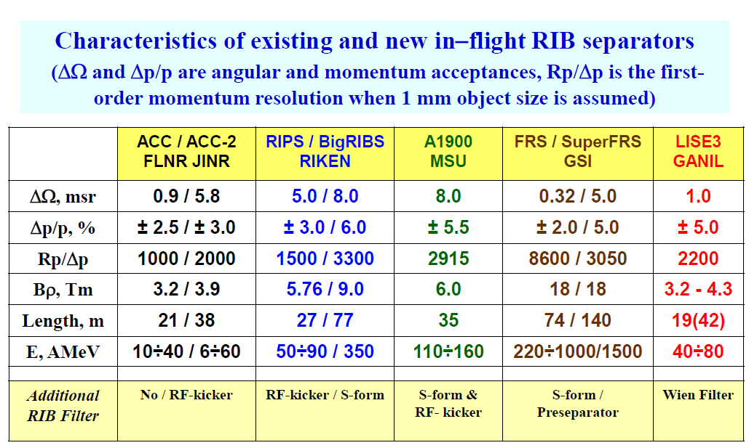
Acculinna-2 in perspective

Slide 4
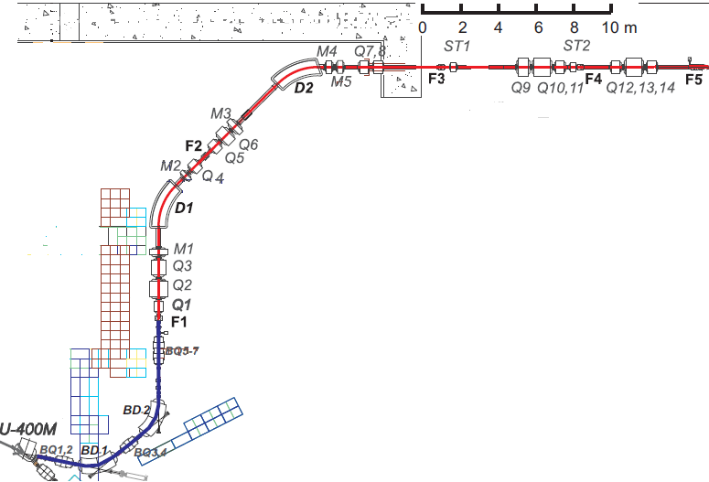
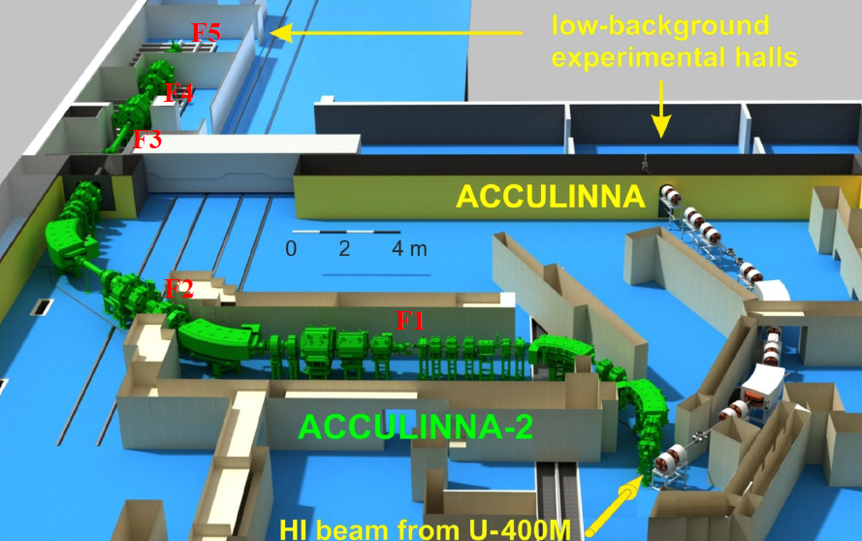
Layout

Slide 5
From contract to installation
October 2011 to December 2013

Slide 6
Scope of Sigmaphi’s responsibility
Optics check
All magnets
All power supplies
All vacuum
Installation
Alignment
Being in control of these 4 techniques gives full freedom for an optimized design leading to an energetically efficient and cost effective facility
Optimization candidates
Figures of merit
Shaping chambers to reduce bores
Trading gradient for length
Standardizing magnets … within limits
Trading current for turns
Trading copper for voltage
Using standard power supplies
…
Power consumption
Cost of
Standardization
design
material
fabrication
But above all
preserve functional specs

Slide 7
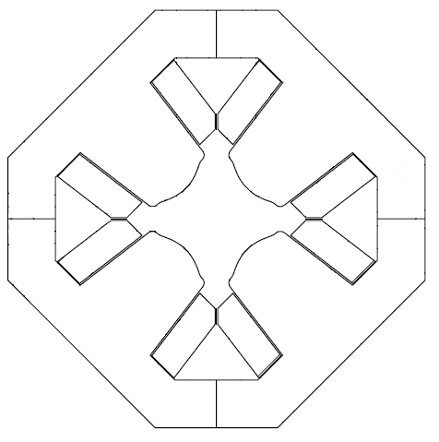
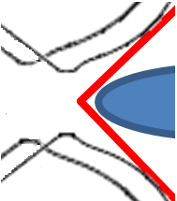
Shaping vacuum chambers to reduce bore
Good field region much closer to pole edge.
Great care in design

Slide 8
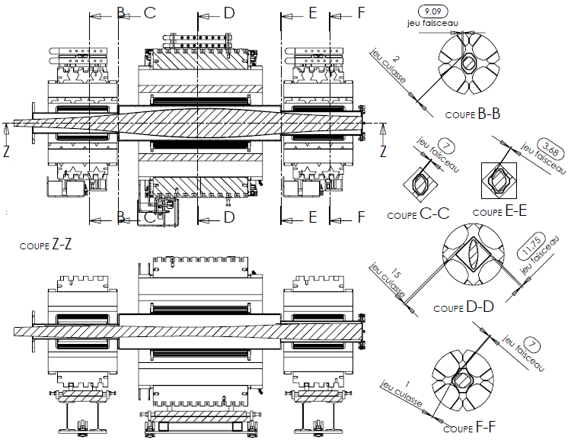
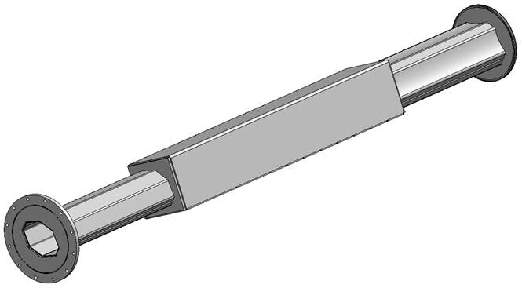
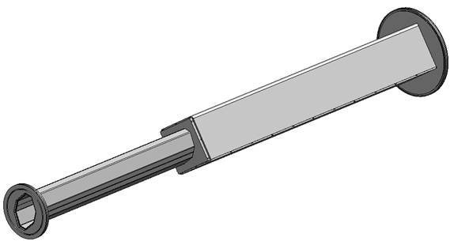
Shaping vacuum chambers to reduce bore
Q14
Q13
Q12

Slide 9
Trading Power supply VS coil
Current
Voltage
For static magnets, voltage is decided by Ohm’s law
n & I = Cheap coil & power supply
n & I = Big coil & power supply
and Pouillet’s law states
Copper = Voltage &
cross-section Power
(U,I) in the range of an existing PS
Aim at low Power
Larger coil
Aim at standardization for coils
Good choice
Gradient - Length
INTEGRATED gradient i.e. gradient times length is important to the beam
Gradient can be traded for length if
Optics remains OK
Space between elements permits

Slide 10
Standardization
Standardization groups objects with “similar” properties
Advantages
Huge reduction in cost for design, tooling and fabrication
Exchangeability and servicing
Drawbacks
Slightly sub-optimal design
Higher material costs
PARTIAL standardization might already help a lot keeping most of the advantages while taming drawbacks
Example of Secondary quadrupoles
1 lamination, 1 length, 1 coil
QM11 (1 item) = Q1
QM21 (1 item) = Q2
QM22 (7 items) = Q4,Q5,Q7,Q8,Q11,Q12,Q14
QM31 (1 item) = Q3
QM32 (4 items) = Q6,Q9,Q10,Q13
1 lamination, 2 lengths, 2 coils
1 lamination, 2 lengths, 2 coils
3 lamination, 5 coils, 5 designs instead of 14

Slide 11
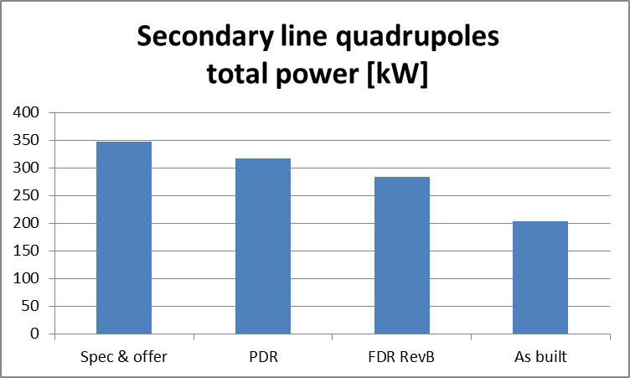
Optimization reduces operation costs
… for years !
Grouping
Reducing bore with tailored chambers
More copper to reduce power supply and PS standardization
41% savings in power consumption

Slide 12
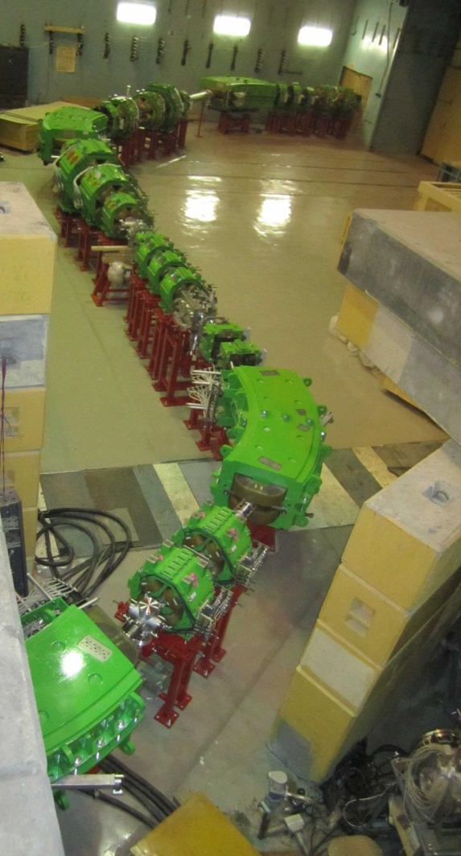
Installation from start to end
January 2014 – March 2015
Room 1

Slide 13
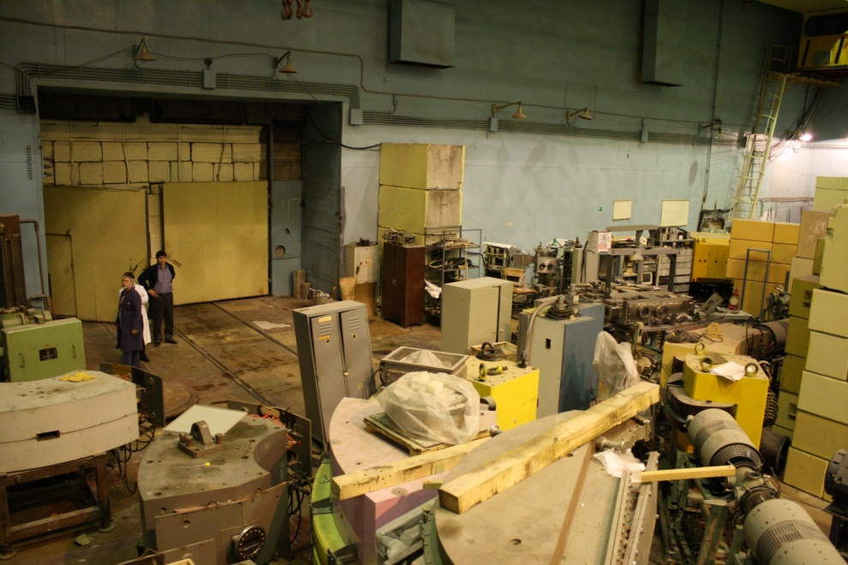
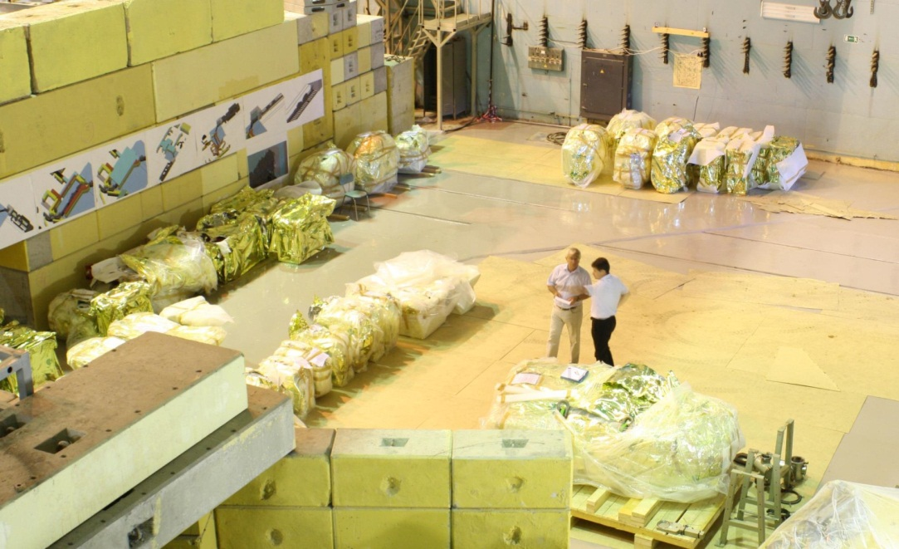
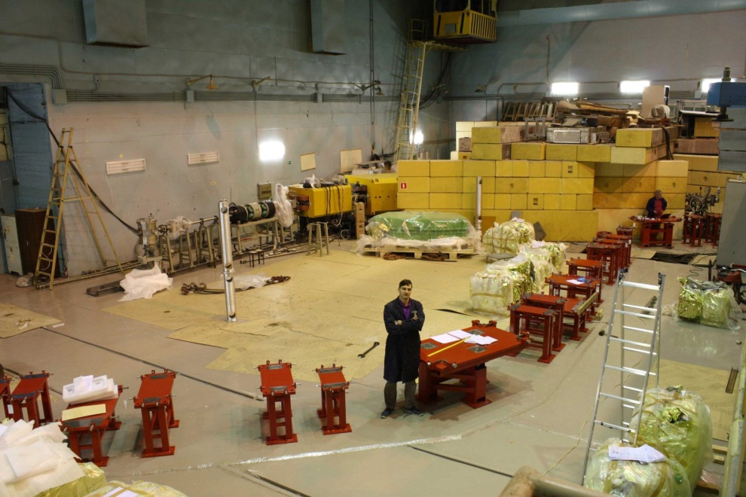
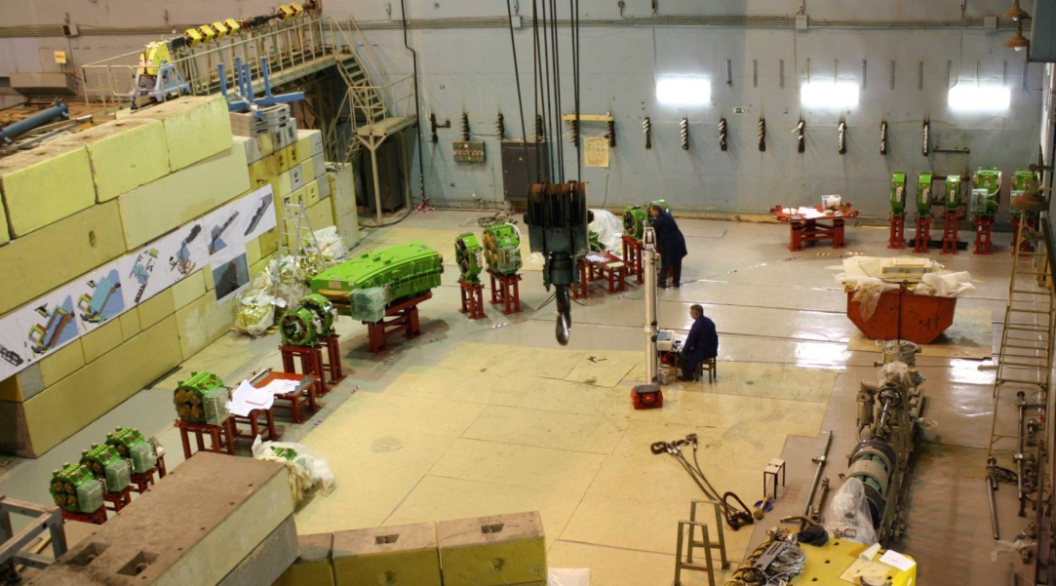
Installation from start to end
January 2014 – March 2015
Before January 2014
January 2014
September 2014
September 2014

Slide 14
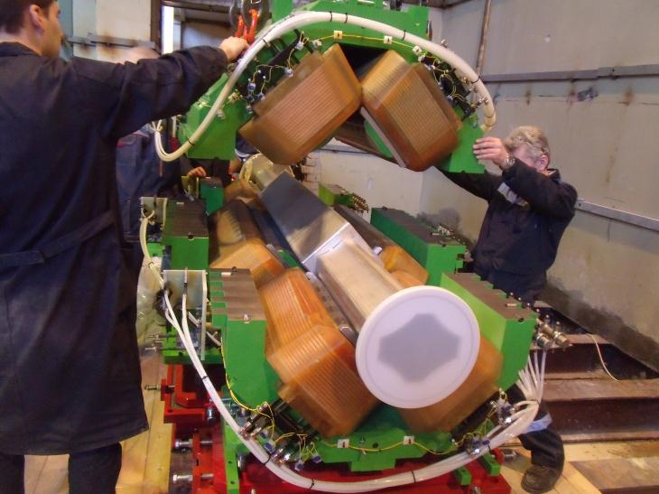
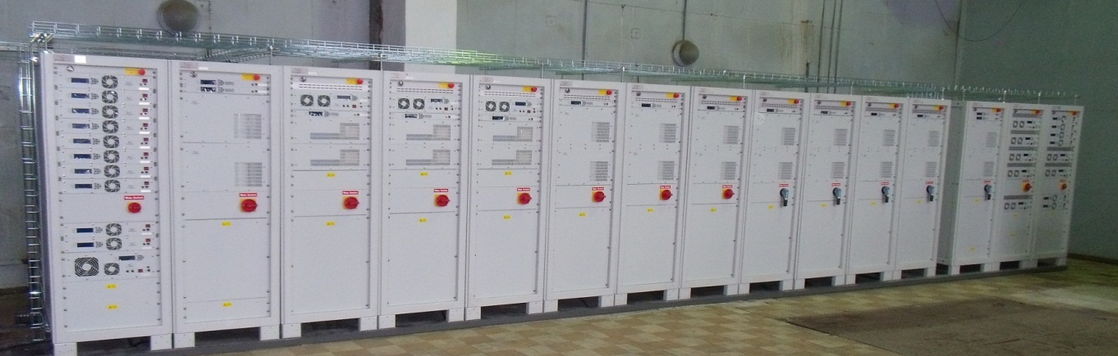
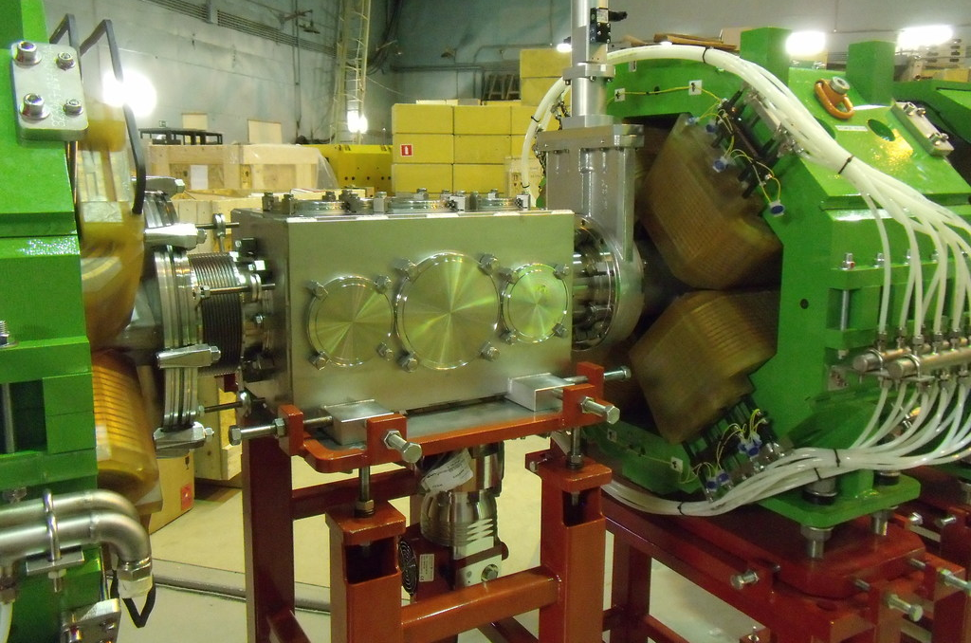
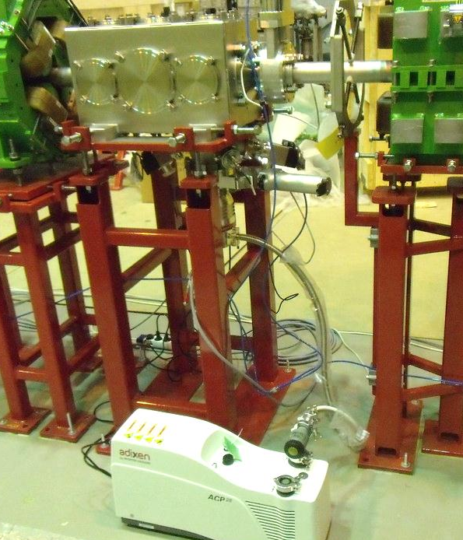
Installation of power supplies and vacuum

Slide 15
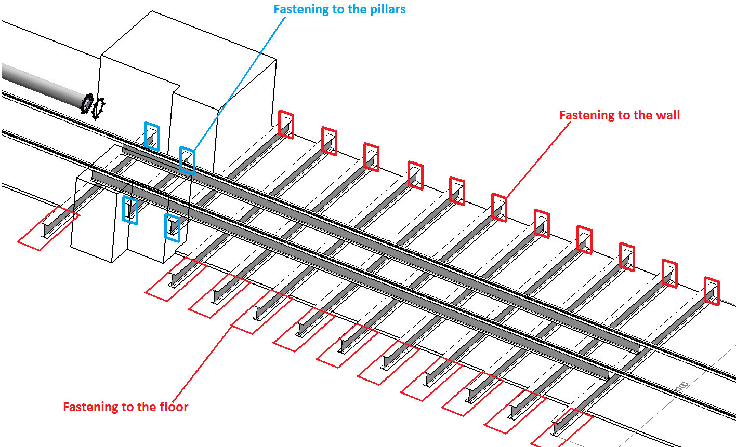

Floor reinforcement in Room 2
Room 2

Slide 16
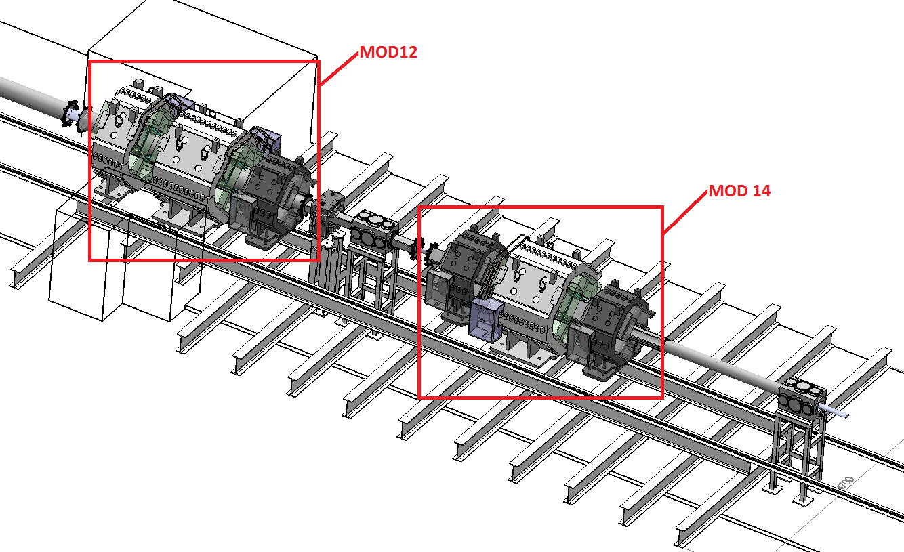
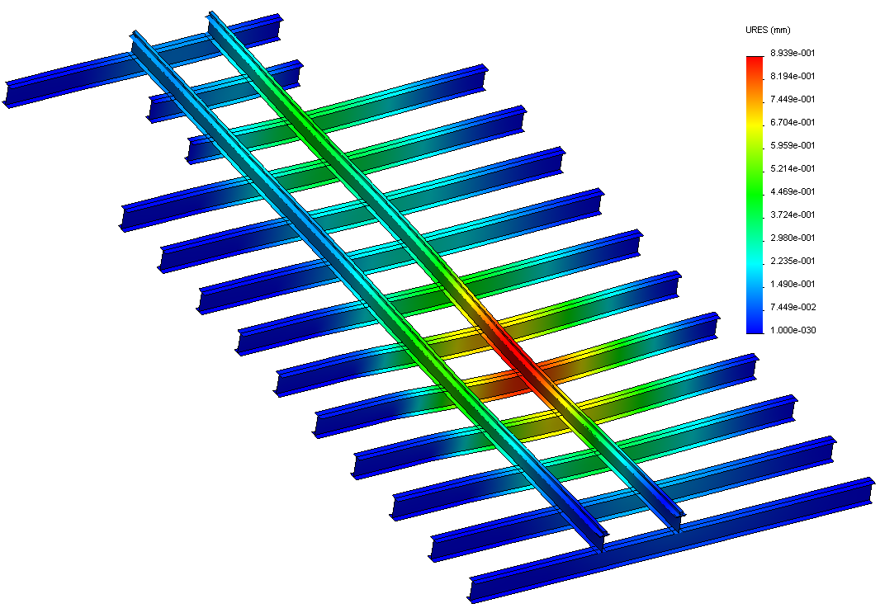
Floor reinforcement in Room 2
Room 2
Resistance limited to 1 ton/m²
~11 tons
~9.1 tons

Slide 17
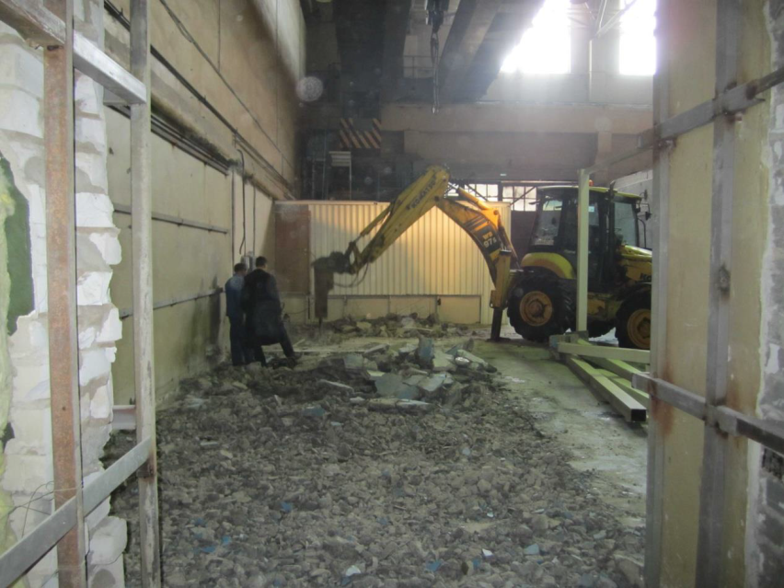
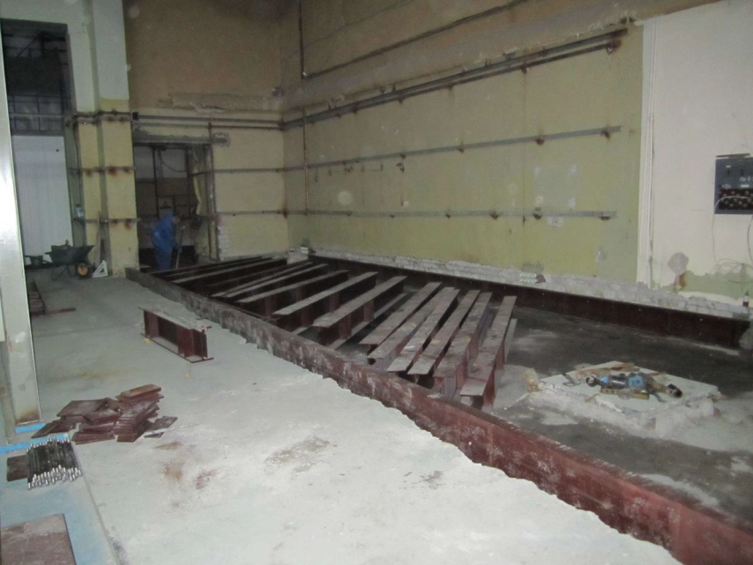
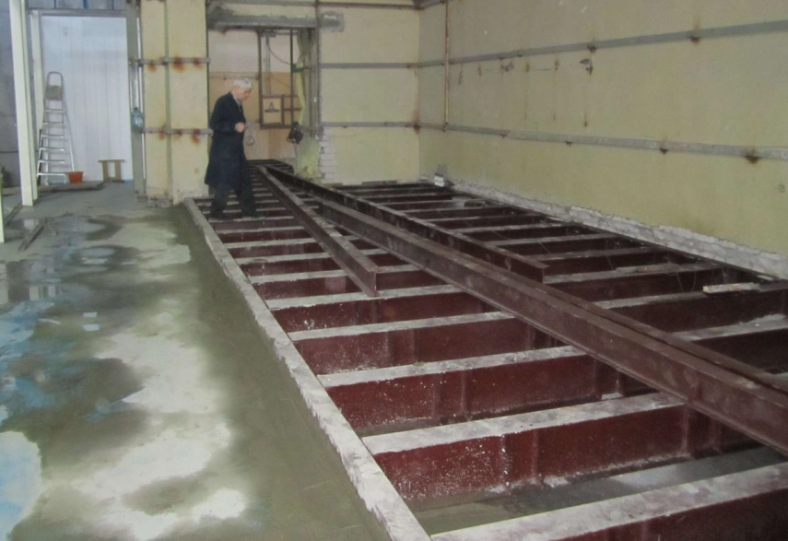
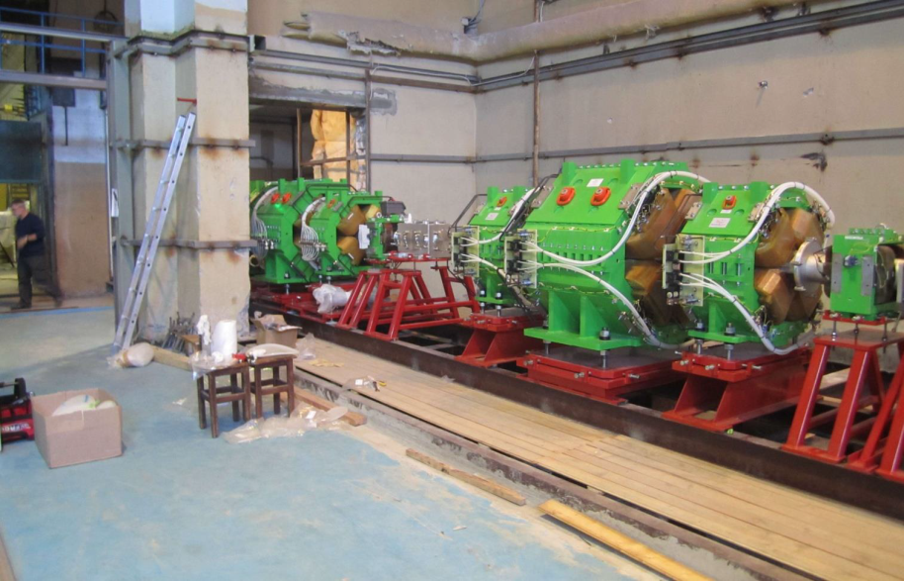
Floor reinforcement in Room 2
Febr 18 2015
March 2 2015
Building structure pillars
March 6 2015
March 17 2015

Slide 18
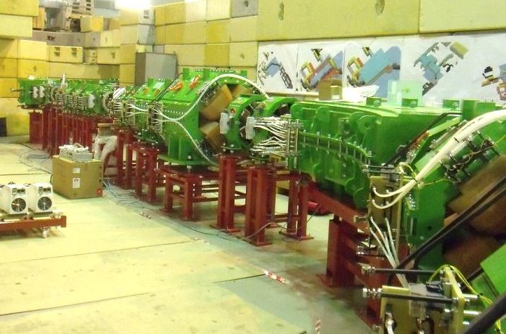
Alignment
Leica laser tracker AT401
Alignment accuracy within ± 0.1 mm

Slide 19
Conclusion
ACCULINNA-2 is fully installed and commissioned. Running started a few weeks ago.
Last week: Beam hit target F2 with 100% transmission.
It is on time and on budget.
A global contract for all hardware has opened the possibility for thorough optimization and drastic improvements of the long term operation costs.
A wonderful human experience!
Near future:
  Zero-angle dipole spectrometer designed, production starts soon, delivery : June 2016
  Cryogenic tritium target in 2017

Slide 20
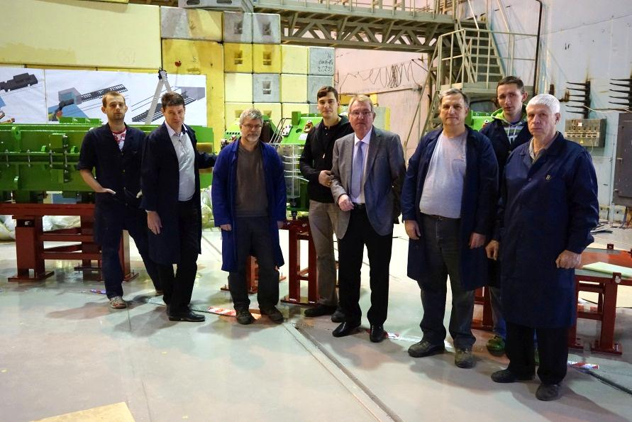
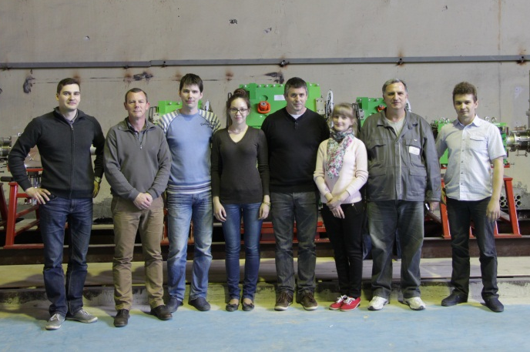
Thank you for your attention
धन्यवाद
Спасибо

Slide 21
Back up slides

Slide 22
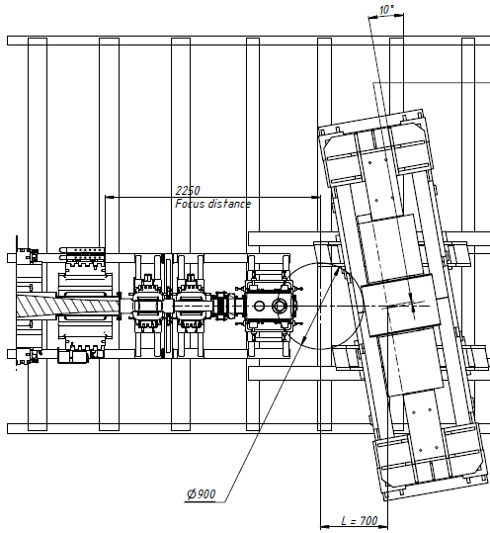
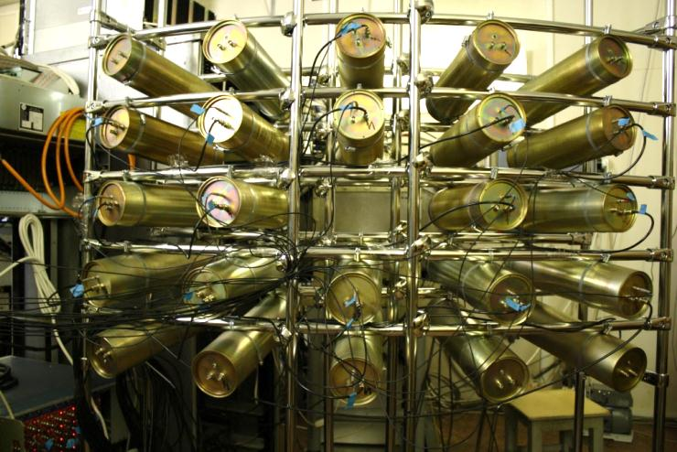
Zero angle spectrometer
Si DE-E annular
telescopes near the target
Position sensitive hodoscope (multi-wire proportional chambers)
Protons
Bρ = 0.4 ~ 1.0 Tm
Cone 0 ~ 14°
Bρ=1.0
Bρ=0.4
Bρ=1.1
Bρ=1.7
±14°
±6°
Neutron detector
Stylbene crystals scintillator array
distance to F5 > 3m
TOF accuracy 1%
Heavy decay products
Bρ = 1.1 ~ 1.7 Tm
Cone 0 ~ 6°

Slide 23
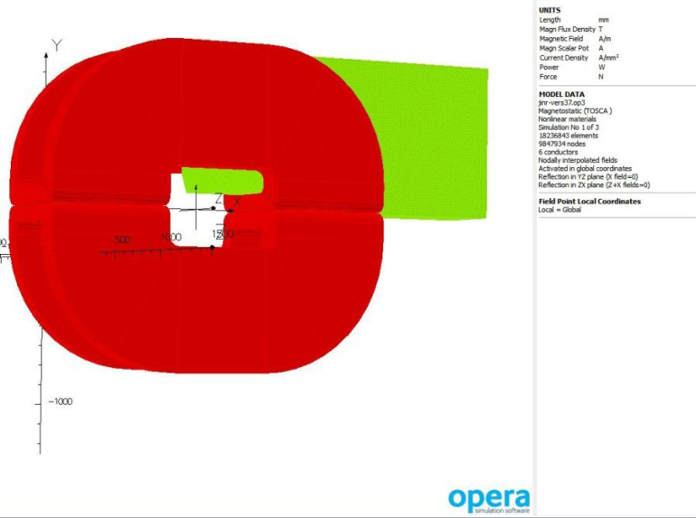
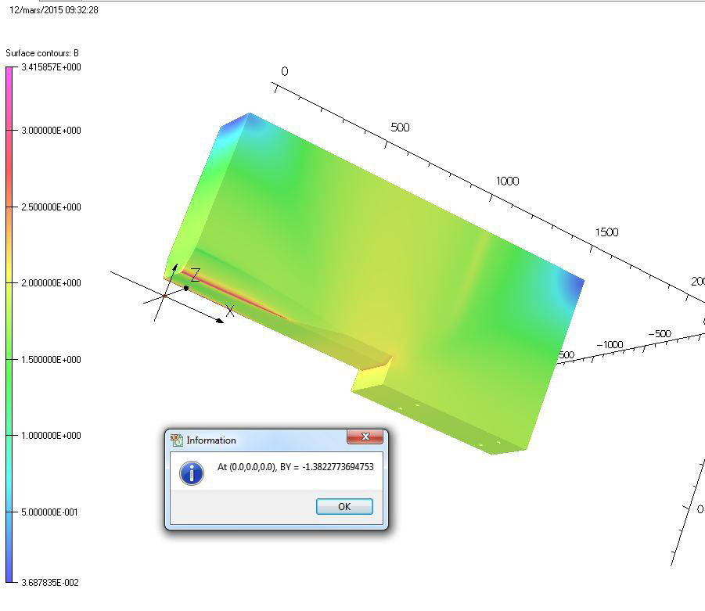
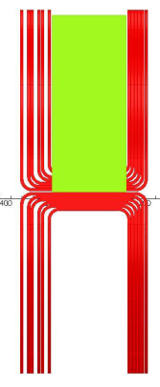
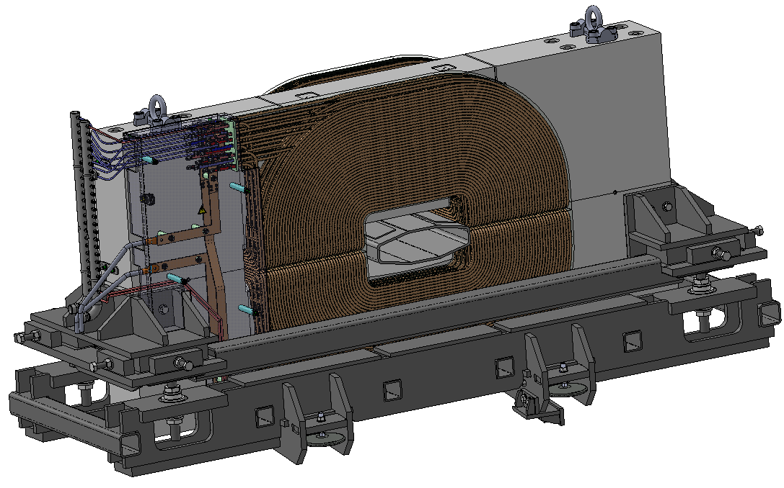
Zero angle spectrometer
Yoke 12.2 tons
Coils 3 tons
0.3m
3.3m
1.6m

Slide 24
Costs
Costs coincides vey well with early predictions
The separator itself (same cost for RIPS at RIKEN)
All communications (electricity, water, vacuum)
Zero degree spectrometer
Civil constructions (new cabin, production target and radiation shell)
Beam diagnostics and vacuum control (Faraday cups, slits, profilometers, tof-detectors, valves etc)
RF kicker (in the plan for the next 7 years)
New tritium target (gas-vacuum system, safety surroundings etc)
Total for ALL planned equipment
In M$
5
0.1
0.3
0.25
0.15
1
1
7.8
Known
Estim’d
Relatively low cost of our setup is explained by
existing infrastructure (cyclotron, experimental hall, communications etc);
simple and cost effective design (no SC elements, no high tech, optimized system)
A pigmy compared to FAIR (~1200 M€), FRIB (450 M$), BigRIPS or SPIRAL2

Slide 25
References
Acculinna webpage + list of publications
http://aculina.jinr.ru/acc-2.php
An extended study of the Acculinna2 configuration with LISE++
http://lise.nscl.msu.edu/9_4/acculinna2/9_4_acculinna2.pdf
Research program for the radioactive beams of the ACCULINNA-2 separator
http://aculina.jinr.ru/pdf/Research%20Program%20for%20the%20Radioactive%20Beams%20of%20the%20ACCULINNA-2%20Separator.pdf
The status of new fragment separator ACCULINNA-2 project and the first day experiments
http://aculina.jinr.ru/pdf/epjconf_inpc2013_11021.pdf

